Slide 1
Big Data Using Hadoop
By – Ramit Kundu.

Slide 2
Big Data
Big Data is also a data but with a huge size. Big Data is a term used to describe collection of data that is huge in size and yet growing exponentially with time. These data’s are so large and complex that none of the traditional data management tools are able to store it or process it efficiently.
Examples: Social Network, Sensors, Stock etc.

Slide 3
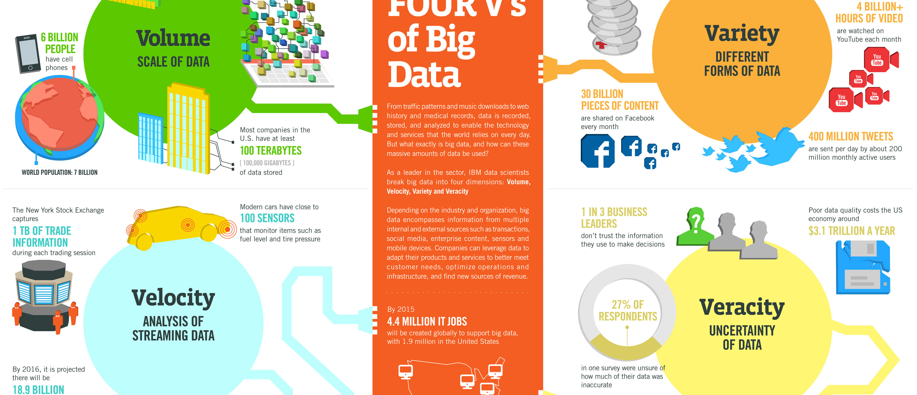
Characteristics of big data

Slide 4
Characteristics:
Volume - It refers to the huge amount of data that is generated.
Variety - It refers to the different types of data i.e. structured, unstructured and semi structured.
Velocity – It refers to the speed at which the data is generated.
Veracity – Trustworthiness of data.

Slide 5
Hadoop Ecosystem
Hadoop Ecosystem is neither a programming language nor a service, it is a platform or framework which solves big data problems.

Slide 6
Components of Hadoop: HDFS(Hadoop Distributed File System)
Hadoop File System was developed using distributed file system design. It is run on commodity hardware. Unlike other distributed systems, HDFS is highly fault tolerant and designed using low-cost hardware.
HDFS holds very large amount of data and provides easier access. To store such huge data, the files are stored across multiple machines.

Slide 7
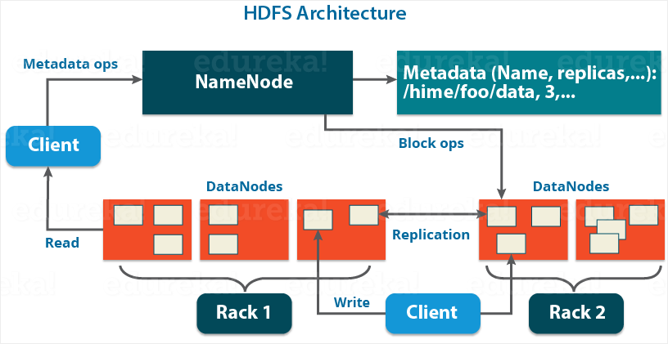
HDFS Architecture

Slide 8
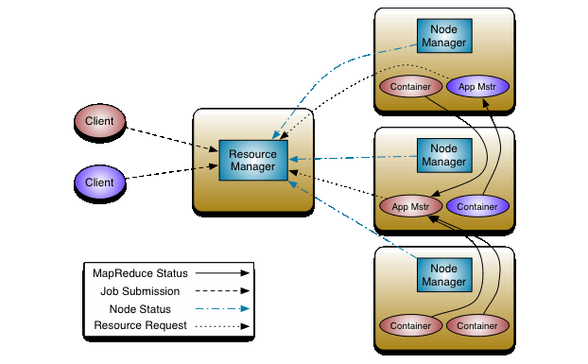
YARN Architecture

Slide 9
MapReduce
Hadoop MapReduce is a software framework for easily writing applications which process vast amounts of data (multi-terabyte data-sets) in-parallel on large clusters (thousands of nodes) of commodity hardware in a reliable, fault-tolerant manner.
A MapReduce job usually splits the input data-set into independent chunks which are processed by the map tasks in a completely parallel manner. The framework sorts the outputs of the maps, which are then input to the reduce tasks. Typically both the input and the output of the job are stored in a file-system. The framework takes care of scheduling tasks, monitoring them and re-executes the failed tasks.
The MapReduce framework consists of a single master Job Tracker and one slave Task Tracker per cluster-node. The master is responsible for scheduling the jobs' component tasks on the slaves, monitoring them and re-executing the failed tasks. The slaves execute the tasks as directed by the master.

Slide 10
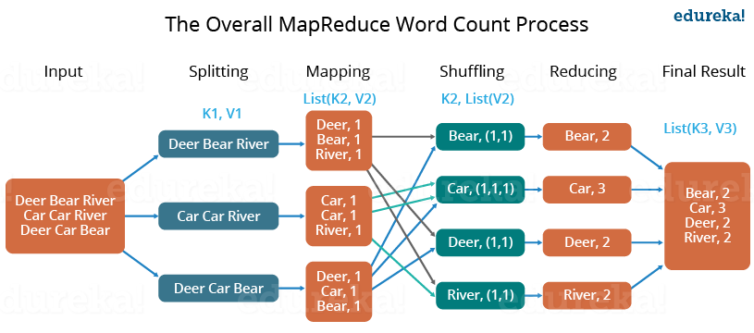

Slide 11
Hive
The Apache Hive is a data warehouse software which facilitates reading, writing, and managing large datasets residing in distributed storage using SQL.
It stores schema in a database and processed data into HDFS.
It is designed for OLAP.
It provides SQL type language for querying called HiveQL or HQL.
It is familiar, fast, scalable, and extensible.

Slide 12
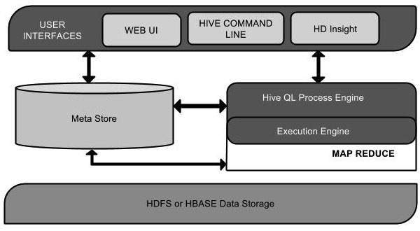
Hive architecture

Slide 13
Pig
Apache Pig is a high-level language platform developed to execute queries on huge datasets that are stored in HDFS using Apache Hadoop. It is similar to SQL query language but applied on a larger dataset and with additional features. The language used in Pig is called Pig Latin. It is very similar to SQL. It is used to load the data, apply the required filters and dump the data in the required format. It requires a Java runtime environment to execute the programs. Pig converts all the operations into Map and Reduce tasks which can be efficiently processed on Hadoop.

Slide 14
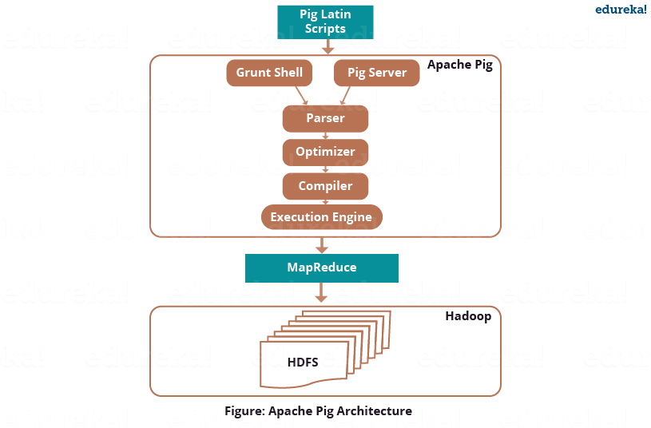
Pig Architecture

Slide 15
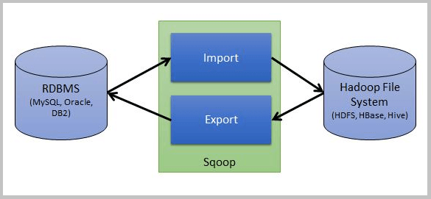
Sqoop
Apache Sqoop is a tool designed for efficiently transferring bulk data between Apache Hadoop and external datastores such as relational databases, etc.
Sqoop is used to import data from external datastores into Hadoop Distributed File System or related Hadoop eco-systems like Hive and HBase. Similarly, Sqoop can also be used to extract data from Hadoop or its eco-systems and export it to external datastores such as relational databases, enterprise data warehouses. Sqoop works with relational databases such as Teradata, Netezza, Oracle, MySQL, Postgres etc.

Slide 16
H1B Project
The H1B is an employment-based, non-immigrant visa category for temporary foreign
workers in the United States. For a foreign national to apply for H1B visa, an US
employer must offer a job and petition for H1B visa with the US immigration
department. This is the most common visa status applied for and held by international
students once they complete college/ higher education (Masters, Ph.D.) and work in a
full-time position.
We will be performing analysis on the H1B visa applicants between the years 2011-
2016.

Slide 17
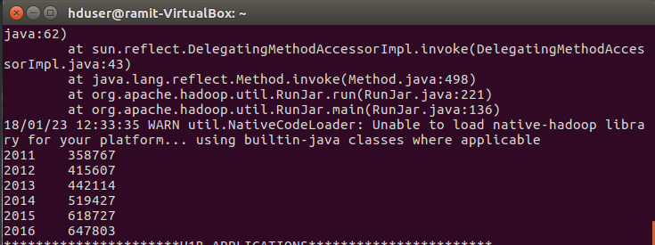
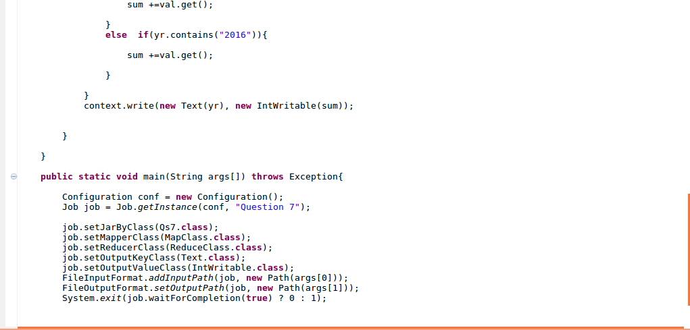
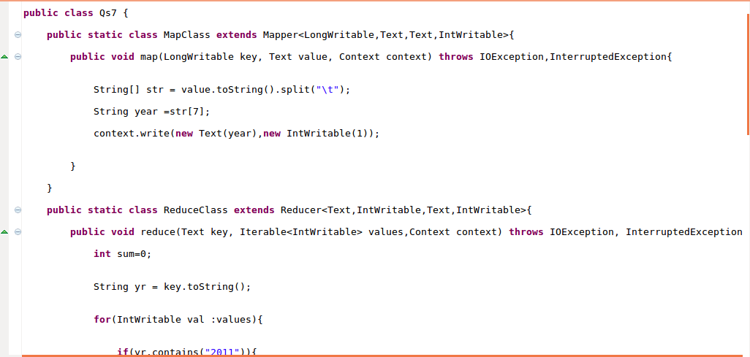
MapReduce Q7

Slide 18
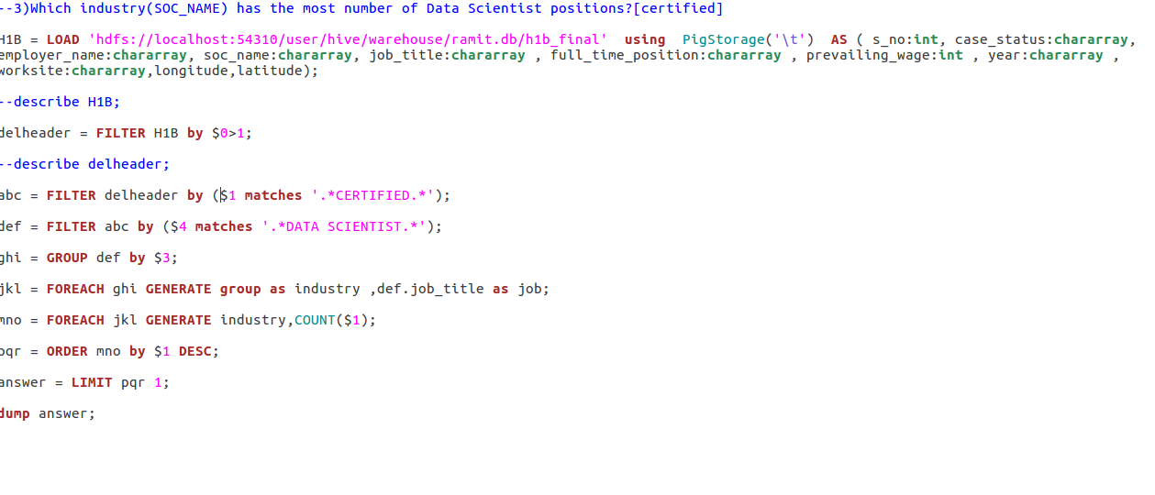
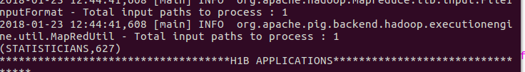
Pig Q3

Slide 19
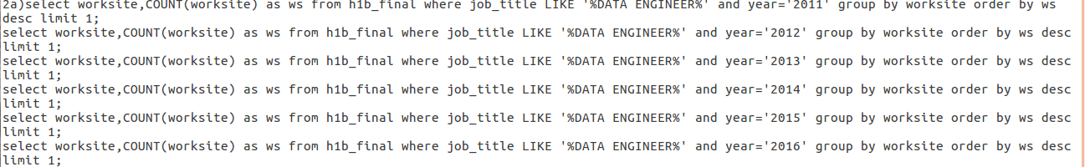
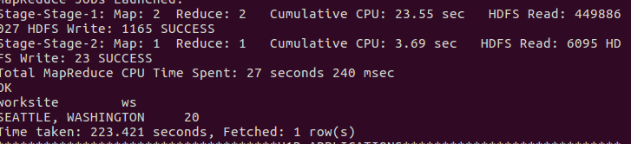
Hive 2a

Slide 20
Conclusion
Hadoop has been a very effective solution for different organisations dealing with huge amount of data sets. It has solved many problems related to huge data management and distributed systems.
Since it is open source , many organisation has adopted it to counter their problems.

